Slide 1

CS123 Digital Logic Design
LECTURE 08
Combinational Circuits Design Problems
Engr.Hammad Munami

Slide 2
Problem 1
Write the sum-of-products expression for a circuit with four inputs and an output that is to be HIGH only when input A is LOW at the same time that exactly two other inputs are also LOW.
Implement the expression of part a using NAND gates only. How many are required?
Engr.Hammad Munami

Slide 3
A | B | C | D | X
0 | 0 | 0 | 0 | 0
0 | 0 | 0 | 1 | 1
0 | 0 | 1 | 0 | 1
0 | 0 | 1 | 1 | 0
0 | 1 | 0 | 0 | 1
0 | 1 | 0 | 1 | 0
0 | 1 | 1 | 0 | 0
0 | 1 | 1 | 1 | 0
1 | 0 | 0 | 0 | 0
1 | 0 | 0 | 1 | 0
1 | 0 | 1 | 0 | 0
1 | 0 | 1 | 1 | 0
1 | 1 | 0 | 0 | 0
1 | 1 | 0 | 1 | 0
1 | 1 | 1 | 0 | 0
1 | 1 | 1 | 1 | 0
Engr.Hammad Munami

Slide 4
Problem 2
Design a logic circuit to produce a HIGH output (out of range) only if the input, represented by a 4-bit binary number, is greater than twelve or less than three. First develop the truth table and then draw the logic diagram.
Engr.Hammad Munami

Slide 5
Problem 3
Develop the logic circuit necessary to meet the following requirements:
A battery-powered lamp in a room is to be operated from two switches, one at the back door and one at the front door. The lamp is to be on if the front switch is on and the back switch is off, or if the front switch is off and the back switch is on. The lamp is to be off if both switches are off or if both switches are on. Let a HIGH output represent the on condition and a LOW output represent the off condition.
Engr.Hammad Munami

Slide 6
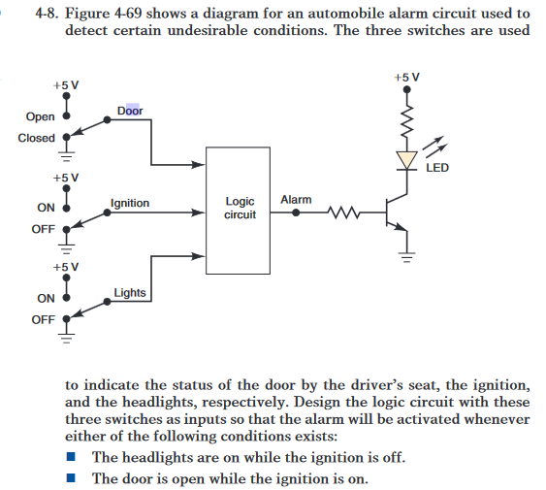
Problem 4
Engr.Hammad Munami

